Slide 1
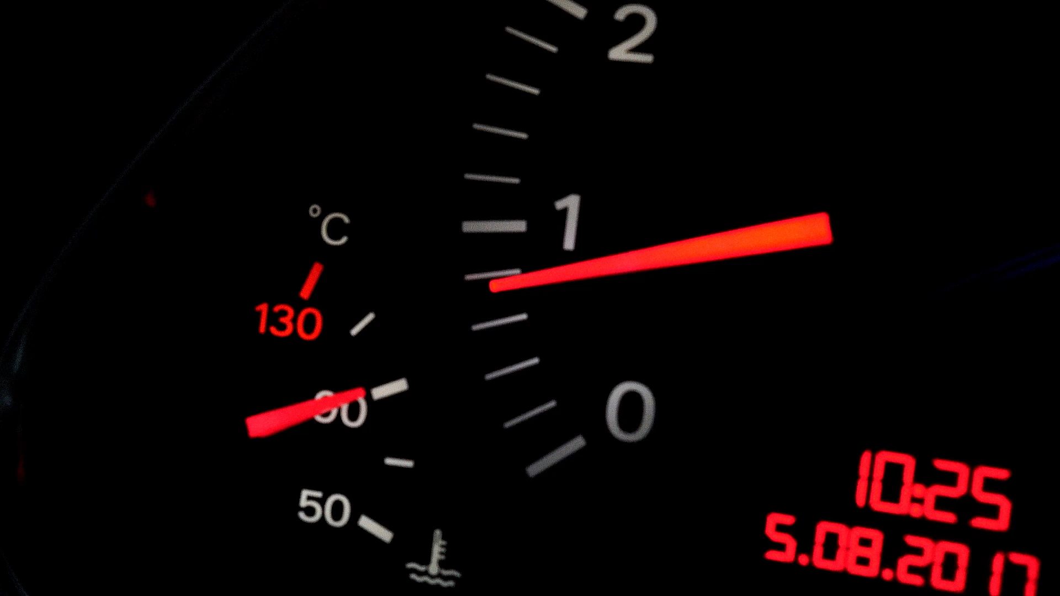
PRICE FOR CAR’s FEATURE
This project helps to know how features in a car varies along with the pricing
- SUMMIT TABHANE

Slide 2

PROJECT ROADMAP
OVERVIEW & DATA CLEANING
POPULARITY VARIATION WITH MARKET CATEGORY
ENGINE POWER WITH PRICE
AVG PRICE WITH BRAND
FUEL EFFICIENCY WITH CYLINDER
DASHBOARD

Slide 3
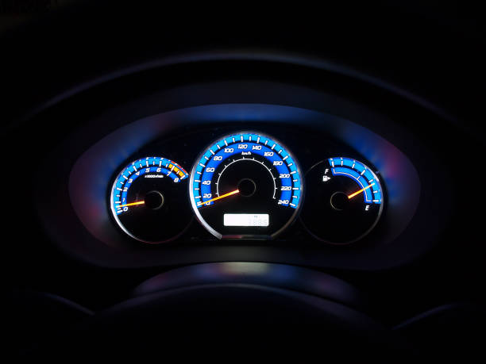
OVERVIEW
Objective : This project helps car manufacturer optimize the pricing and product development by analyzing how car features influence pricing and profitability.
Dataset Source : The dataset contains over 11,000 car models collected from Edmunds.com via Kaggle, covering specifications like fuel type, engine power, market category, and MSRP.
Business Problem : In a highly competitive and evolving auto industry, manufacturers need data-driven strategies to align with consumer demand and remain profitable.
Key Tasks : The project includes regression analysis, pivot tables, correlation study, and interactive dashboards to uncover insights related to popularity, pricing, and performance.
Feature Analysis : Relationships between MSRP and factors like engine horsepower, transmission type, market category, and fuel efficiency were explored using visualizations and Excel formulas.
Interactive Dashboard : An Excel dashboard was created using slicers, filters, combo charts, scatter plots, and bubble charts to make insights easily interpretable and actionable.
Insights & Impact : The analysis identified high-profit segments, cost-sensitive features, and market preferences, guiding product planning and pricing strategies.

Slide 4
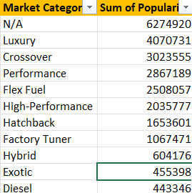
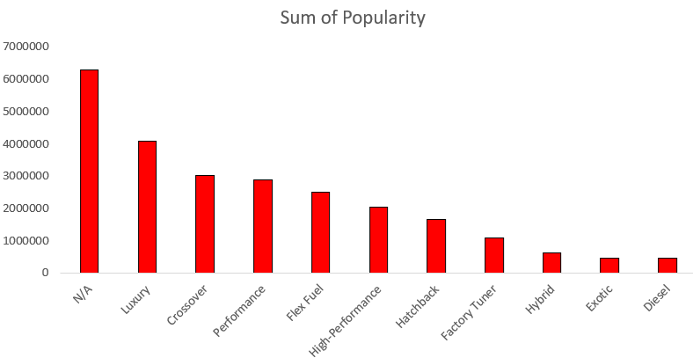
VARIATION OF POPULARITY WITH MARKET CATEGORY
We analyzed how car popularity varies across different market categories using a pivot table and combo chart. Categories like Luxury, Crossover, and Performance had significantly higher popularity scores, indicating stronger consumer interest.
However, categories like Exotic and Diesel had fewer models and lower overall popularity, suggesting niche appeal. This insight can guide manufacturers in deciding which segments to expand or target based on market demand.
The combo chart helped visualize that while some categories had more models, their popularity was not necessarily high—highlighting the importance of both quantity and consumer preference in product strategy.

Slide 5
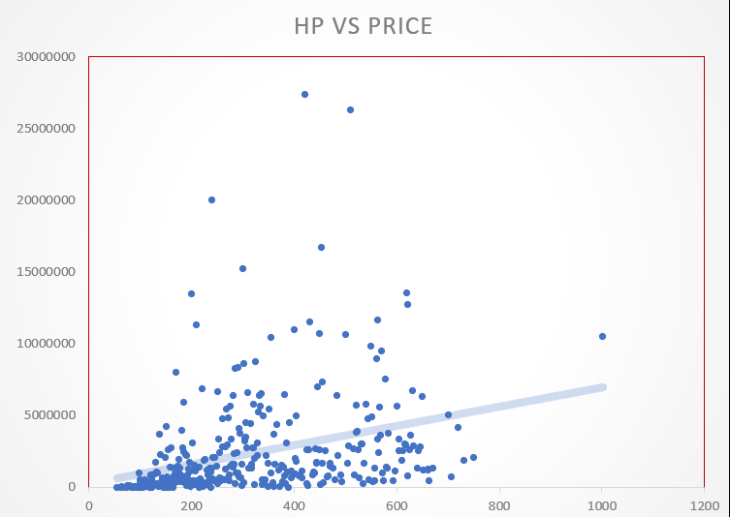
VARIATION OF ENGINE POWER WITH PRICE
To understand how engine power influences pricing, we plotted a scatter chart with Engine Horsepower (HP) on the X-axis and MSRP on the Y-axis. A positive correlation was observed—cars with higher horsepower generally had higher prices.
The linear trendline added to the chart revealed a moderate relationship between the two variables, indicating that engine power is an important but not the sole factor in pricing decisions. The R² value supported this by showing how well engine power alone could explain the variation in price.
This insight can help manufacturers strategically price performance-based vehicles and balance power with affordability for mass-market models.

Slide 6
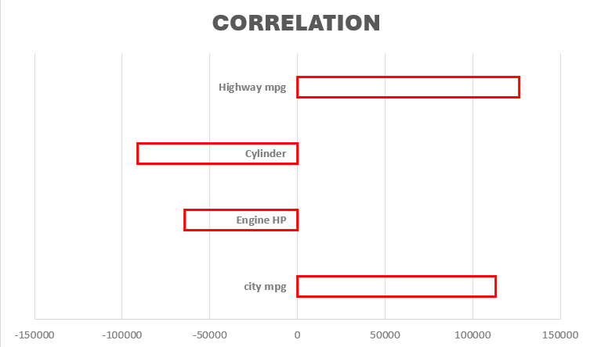
PRICE VARIATION WITH FEATURE
To determine which features, have the most impact on a car’s price, we performed a multiple linear regression using MSRP as the dependent variable and several numerical features (e.g., Engine HP, MPG, Cylinders, Popularity) as independent variables.
The regression results showed that Engine Horsepower and Popularity had the strongest positive influence on price, while Highway MPG showed a negative correlation—indicating that fuel-efficient cars tend to be priced lower. The R² value suggested a good overall fit for the model.
A bar chart of coefficient magnitudes was used to visualize the relative importance of each feature. These insights help identify key selling points for pricing strategy—particularly in performance or luxury segments.

Slide 7

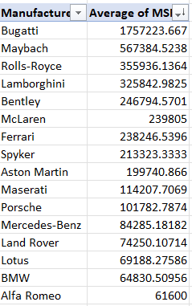
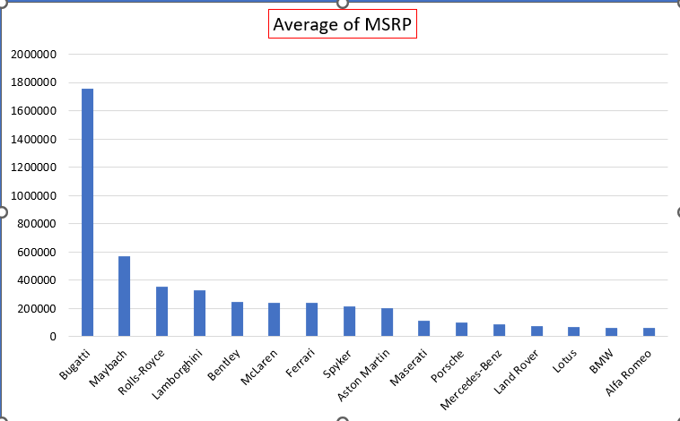
AVERAGE PRICE OF BRANDS
We analyzed the average price of cars across different manufacturers using a pivot table and bar chart. The results highlighted a significant variation in pricing strategies between brands.
Luxury and exotic brands like Rolls-Royce, Bugatti, and Maybach had the highest average MSRPs, indicating a focus on premium market segments. In contrast, mass-market manufacturers such as Kia, Hyundai, and Chevrolet showed significantly lower average prices, aligning with their affordability-driven offerings.
This comparison provides valuable insight into how manufacturers position themselves in the market, helps identify competitors within each pricing tier.

Slide 8

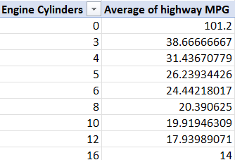
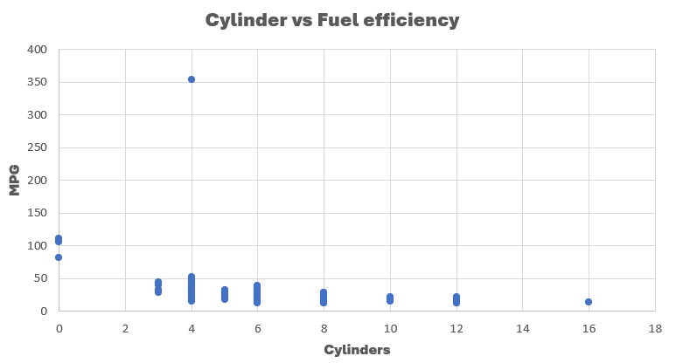
AVERAGE FUEL EFFICIENCY PER CYLINDER
To explore the relationship between engine size and fuel efficiency, we plotted Engine Cylinders vs. Highway MPG and added a linear trendline. The resulting graph showed a clear negative correlation — as the number of cylinders increases, fuel efficiency tends to decrease.
This was confirmed by the correlation coefficient, which was strongly negative, indicating that higher cylinder counts typically result in lower highway mileage. This makes sense mechanically, as larger engines consume more fuel.
These insights are important for manufacturers targeting fuel-conscious customers and can guide decisions around engine configurations for efficiency-focused models.

Slide 9
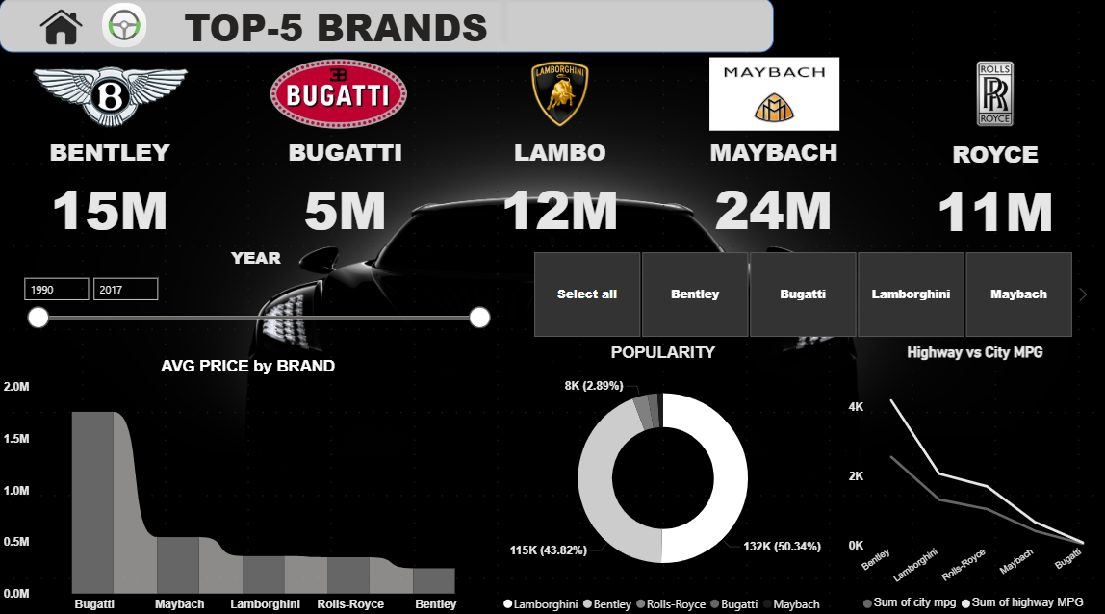

Slide 10
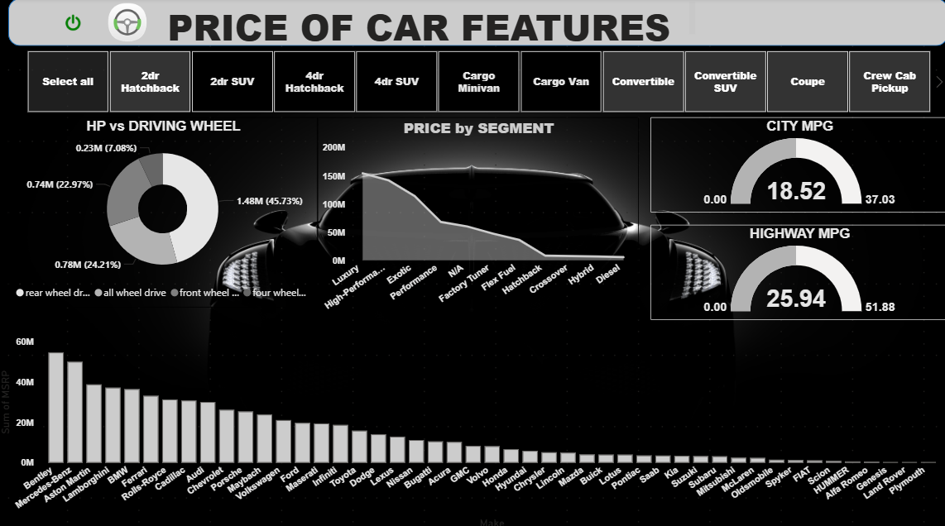

Slide 11
